Slide 1
CSCE 823 In Class Day 10
ANN Training: CNN
Live Synchronous session

Slide 2
Agenda
Why CNNs?
CNN Key Characteristics, Parameters and Decisions
Visualization Code [Demo only]
General Q&A (If time allows)

Slide 3
CNN Key Topics
Image recognition problem
Problems w/ fully connected networks
Convolution Operation
Efficiency of Convolution
Pooling
Architectures
CNN Backprop
Variants on Basic Convolution
Data Types
Neuroscience Basis
Understanding CNNs with visualization

Slide 4
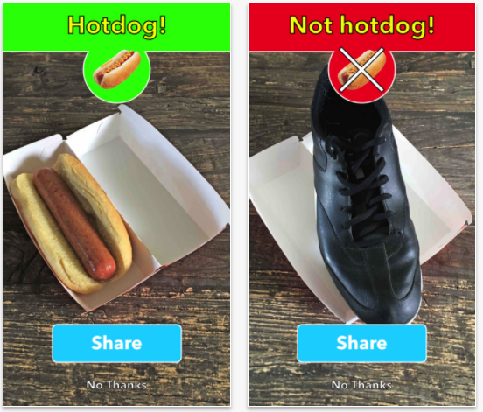
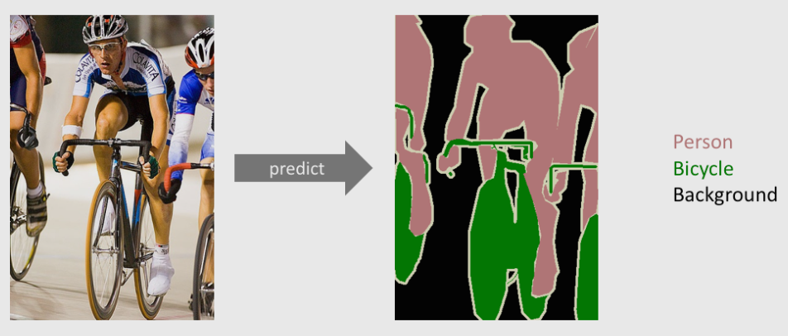
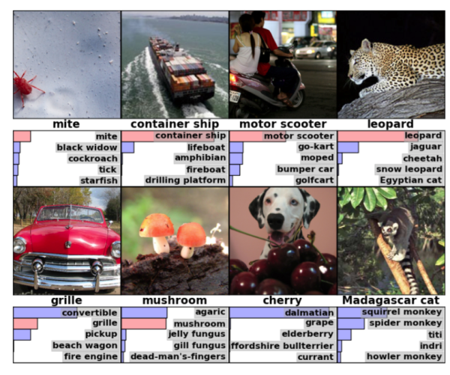
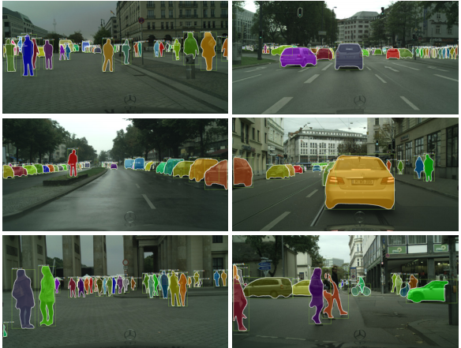
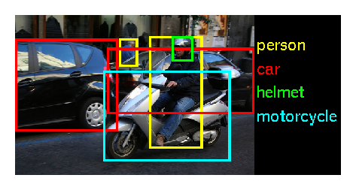
Common Image Recognition Tasks
Semantic segmentation
Binary classification
Multi-way Classification
Top-N classification
Instance segmentation
(multi) Object Detection

Slide 5
Why fully-connected MLPs are not scalable with image size
Suppose we wanted a 1-hidden layer, 1-output layer Fully Connected ANN to do target detection (yes / no)
Binary classification on a (small) greyscale image
256 x 256 x 1 = input size 65536
hidden layer node: 1000; output sigmoid
How many weight parameters for hidden layer? 65M
Binary Classification on color 256 x 256 x 3? 196M
Recalculate for a 4K RGB image:
3840 × 2160 x 3 : 24.8B weight parameters in hidden layer
How many images would be required to train these networks????
…
…

Slide 6
Making Networks Scalable
Fully connected networks are untrainable on even medium-sized inputs
Need to reduce the number of parameters to make training tractable
Key methods
A: Sparse Interactions via convolution
B: Parameter Sharing
C: Equivariant Representations

Slide 7
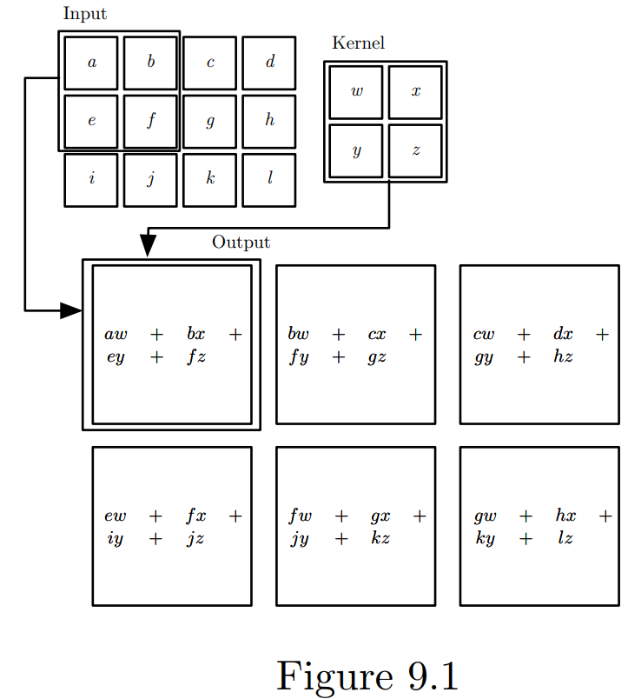
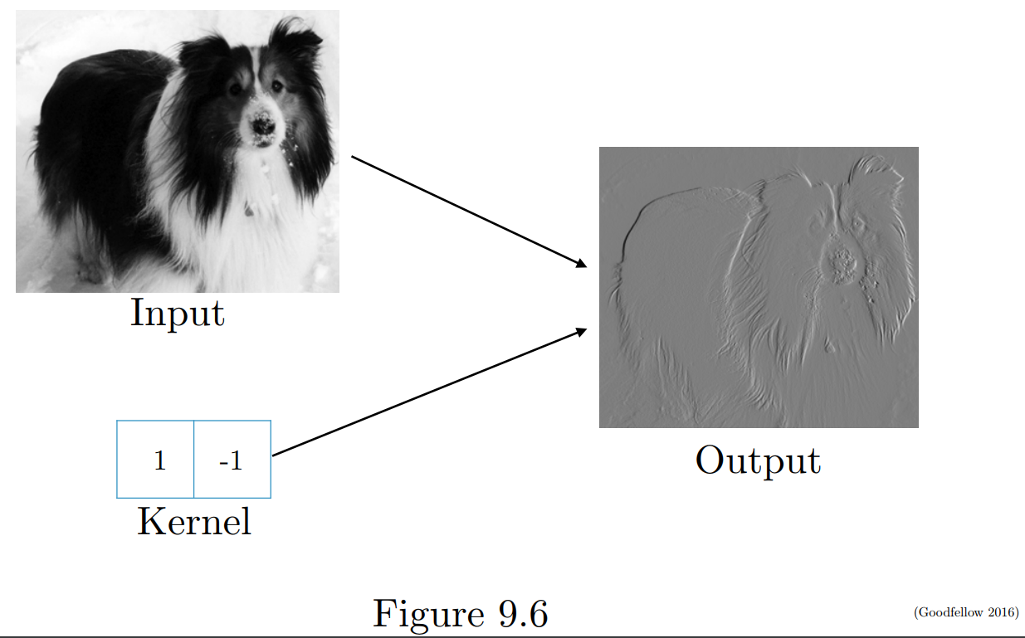
Convolution Kernel (2D) Math
Example of Simple Kernel for Edge Detection
(Goodfellow 2016)

Slide 8
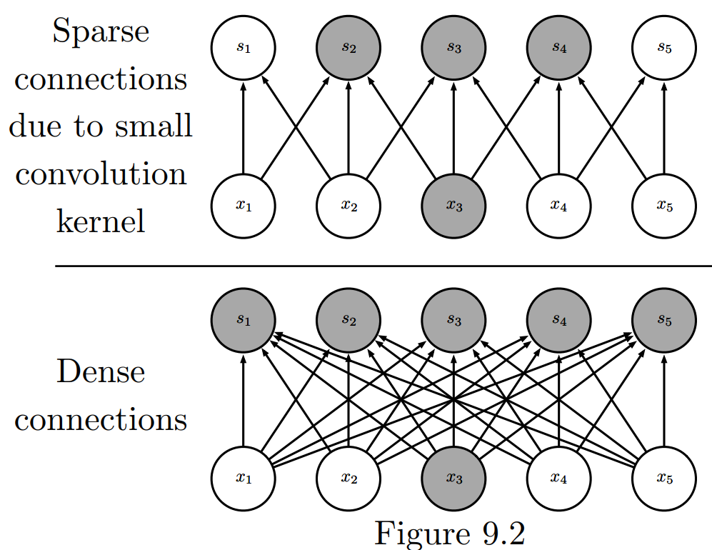
Convolution Implements Sparse Interactions + Parameter Sharing
b
c
a
b
c
a
b
c
a
b
c
a
b
Sharing reduces learned parameters
Unshared: O(Width_{L} x Width_{L+1})
Shared: O(P), where P is not related to layer width (e.g. p=3)
Sparse connections yield fewer parameters to train

Slide 9
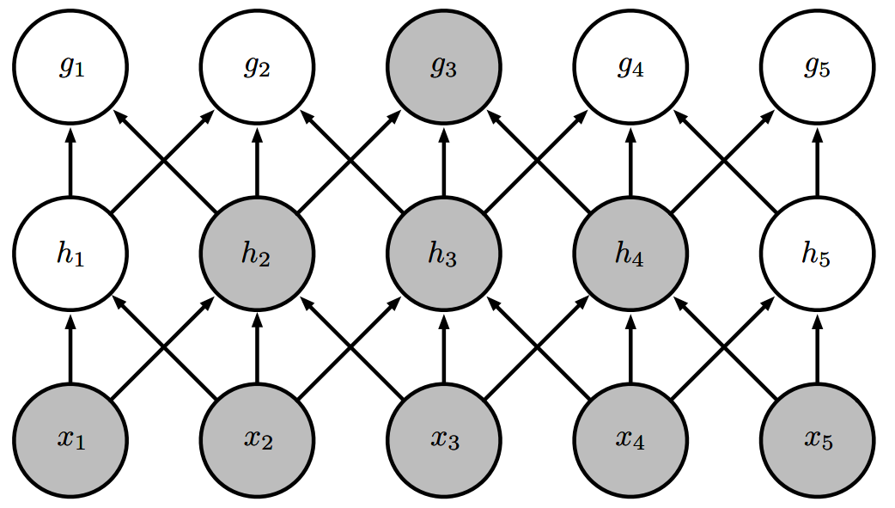
Receptive field
Since CNNs are not fully connected, an input takes more layers to affect an arbitrary node in a later layer
A later nodes’ visibility of information from earlier in the network is its receptive field
Deeper networks allow equivalent receptive fields as shallower, wider networks… but have far fewer parameters (due to being not fully connected and parameter sharing)

Slide 10
Conv + Parameter Sharing: Equivariance to Translation
Convolution creates a map of features in the input
Shifting an image (translation) yields a shifted feature map
Shifting object in image leads to corresponding shift of the feature map
Since parameters are shared in kernels, the image feature can be detected equally well wherever* it is shifted to in the image
Conv alone is not enough to be equivariant to other changes such as rotation or scale
Other techniques required beyond convolution to make a network robust to these (e.g. data augmentation)

Slide 11
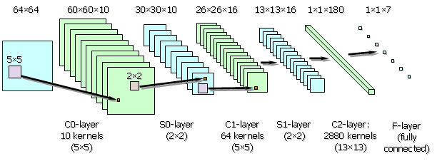
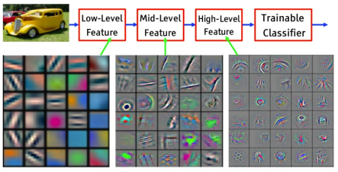
Convolution + activation: detectors (feature maps)
http://www.pspc.unige.it/~drivsco/Research_News/articoli/002/
Feature Visualization of Convolutional Net Trained on ImageNet from [Zeiler & Fergus 2013]
Each Convolution Kernel generates a feature map from the previous layer
Kernels extract features from lower layers
As input sizes are reduced, feature map count grows
Need many kernels to learn many different features
Q: Why don’t all the kernels in a layer end up learning the same thing?

Slide 12
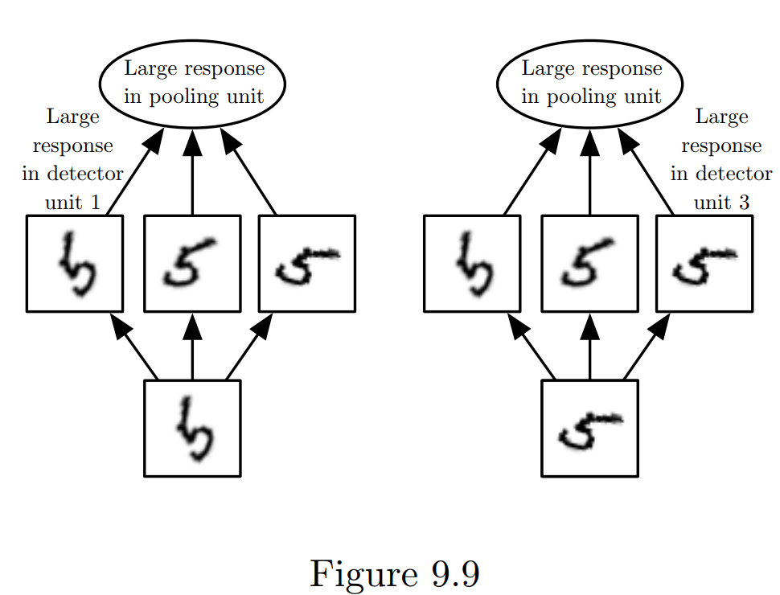
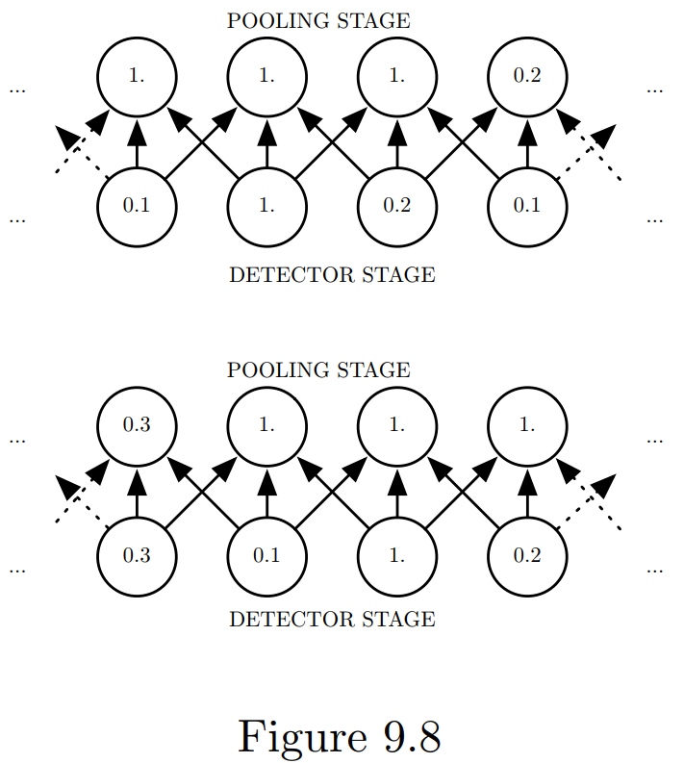
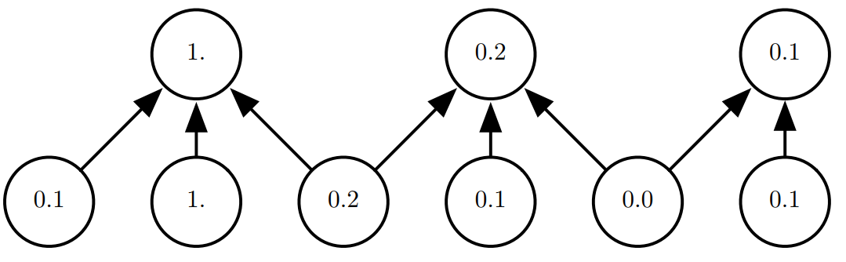
Pooling
Cross-Channel (detector; kernel) Pooling: Invariance to other transformations
Reduce the size of the next layer
Improve invariance to input alterations
Types
Max Pooling
Cross-channel / Cross detector
Down sampling
Max Pooling: Invariance to translation
(max) Pooling with Downsampling:

Slide 13
Important Decisions for CNNs
Stride (how much to shift the kernel)
Padding (introduce values at the edges of the data so the kernel math works)

Slide 14
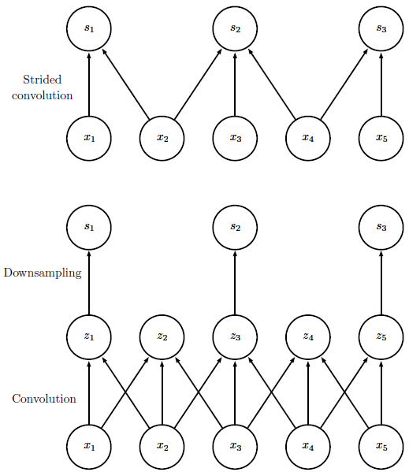
Strided Convolution vs. Downsampling
More efficient
Notice that z₂ and z₄ values are ignored…
Although convolution followed by downsampling used in some research, it is less efficient, and strided convolution provides solutions which are more efficient to train and should yield the same results.
Less efficient

Slide 15
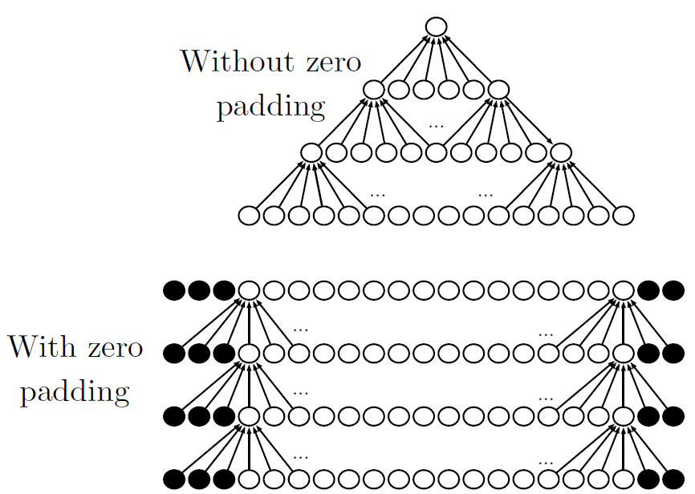
Padding affects max depth
Keras: “Valid Padding”
Max Depth is Limited
Max Depth unlimited
Keras: “Same Padding”

Slide 16
Data types: Dimensions vs. Channels
Dim | Single Channel | Multichannel
1D | Audio Waveform | EEG; temperature over time at multiple points in equipment
2D | Frequency Spectrum of Audio (time x frequency); Grayscale Image | Color Image; Hyperspectral image
3D | Grayscale Video; Volumetric medical imagery; Volumetric atmospheric data; | Color video
Dimension is the count of spatial or temporal dimensions present
Voltage measurement sensor over time = 1D: (t)
Picture = 2D: (vertical index, horizontal index)
Video = 3D: (vertical index, horizontal index, frame/time index)
Channel is the count of simultaneous measurements
Red, Green, Blue channels of an image or video
Recordings of multiple simultaneous voltages in EEG headcap
The definitions of channel and dimension are determined for each ML task

Slide 17
Understanding what CNNs learn with Visualization - DEMO (Chollet / Chapter 9.4)
Detector activations on input
Visualizing convnet filters
Heatmaps of class activation

Slide 18
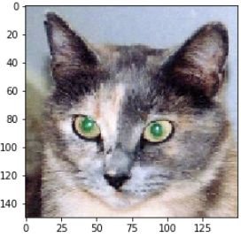
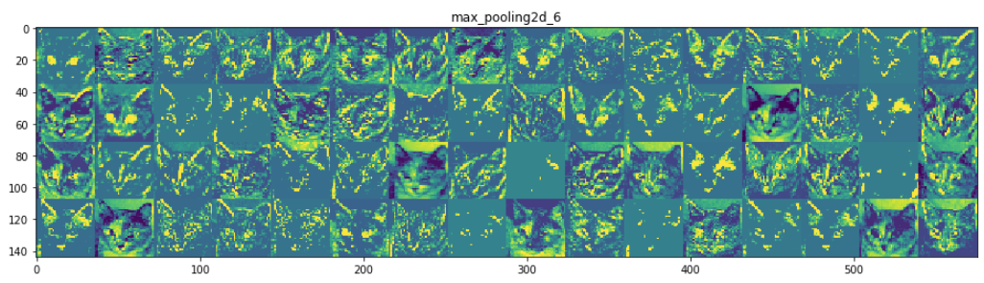
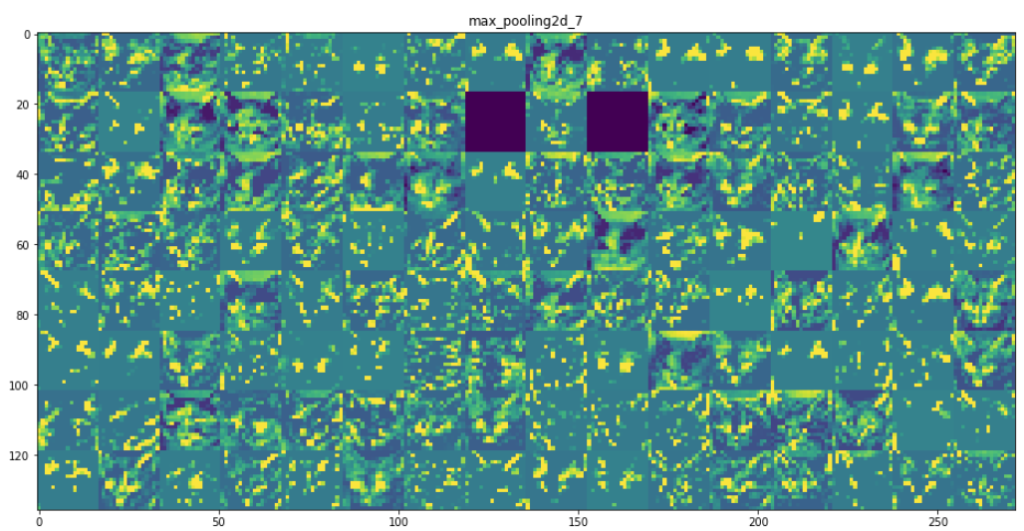
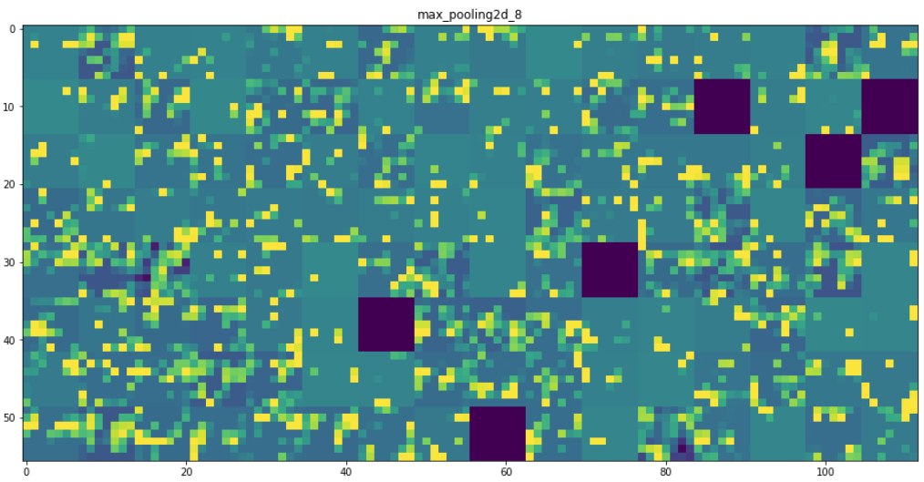
Detector activation on input
Forward pass of image through CNN
Display activation of filters (or maxpools)

Slide 19
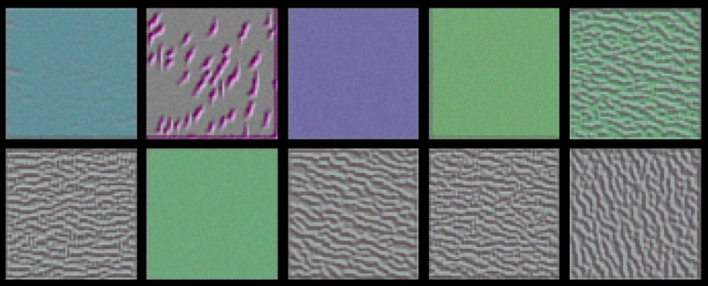
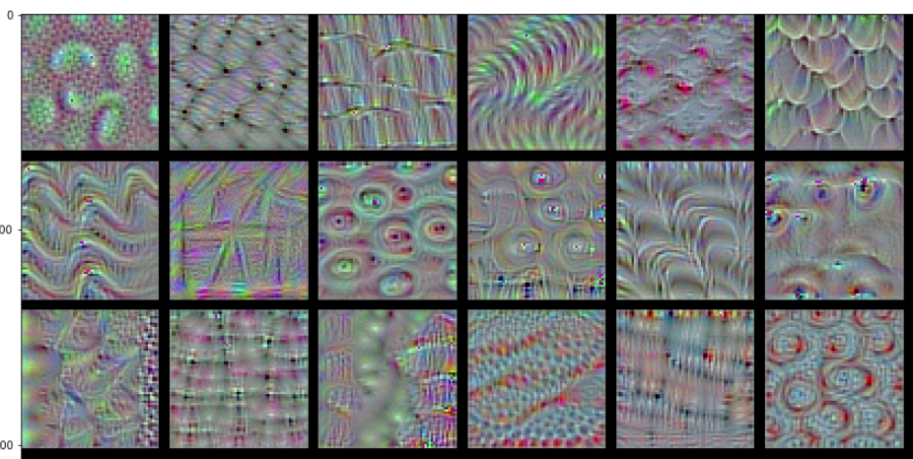
Visualizing convnet filters
Choose a filter
Start with a ‘blank’ input image (neutral value)
Use gradient ascent in the input space to maximize the to value of the filter’s response
Generates the image for which the chosen filter is maximally responsive to

Slide 20
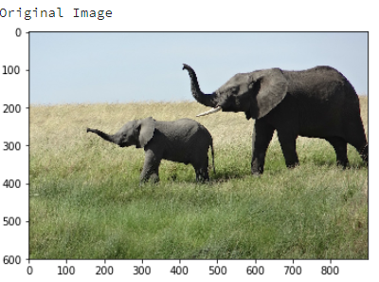
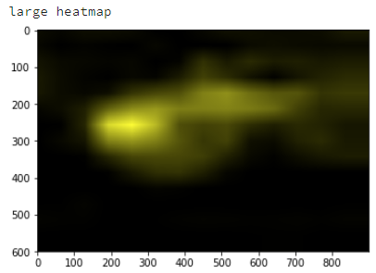
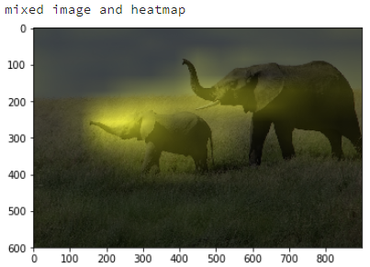
Overlaid Heatmaps of class activation
Pick an image and an image category to check (e.g. “elephant”)
Select the output feature map of a convolution layer
Weigh every channel in that feature map by the gradient of the class with respect to the channel
Reveals what portions of the image the model uses to decide its class is elephant
This method could help diagnose classification errors

Slide 21
Visualization Code Demo
Download zip from canvas & unzip into local directory
The file contains code, data, models, images…
Open jupyter notebook within the unzipped directory (don’t run it)
Review the notebook without running
Even with a modern 30XX Nvidia GPU this will take 10+ minutes to run.
If you have a GPU and have tensorflow installed and want to run it, heed the following…
You will need time to install OpenCV: “conda install -c conda-forge opencv”
Duplicate the notebook so you don’t overwrite the original
Note: Don’t try to run the code without a GPU and all the packages installed (see notes in first markdown cell).
Google colab may or may not work… I have not tested it
Get the zip off canvas; Unzip the file into a directory on your local machine.
The zip contains a jupyter notebook, data, models and other files needed for the demo.
NOTE: if you run it, the notebook will write files to your local directory
Recommendation: Open the jupyter notebook to look at it… but don’t run it
Note: Don’t try to run the code without a GPU and all the packages installed.
Even with a modern 30XX Nvidia GPU this will take several minutes to run.
Google colab may or may not work… I have not tested it
Code inspired by https://github.com/fchollet/deep-learning-with-python-notebooks/blob/master/5.4-visualizing-what-convnets-learn.ipynb

Slide 22
General Q&A

Slide 23
Backup Slides

Slide 24
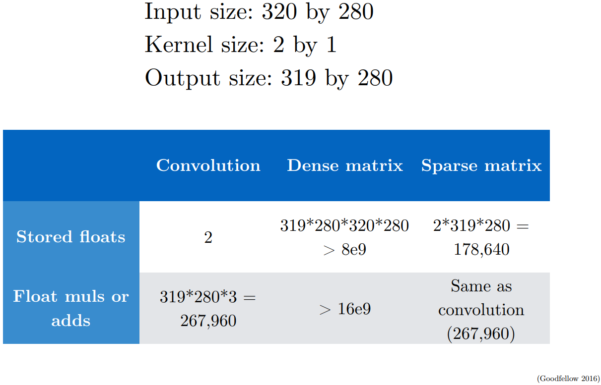
How efficient are CNNs?

Slide 25
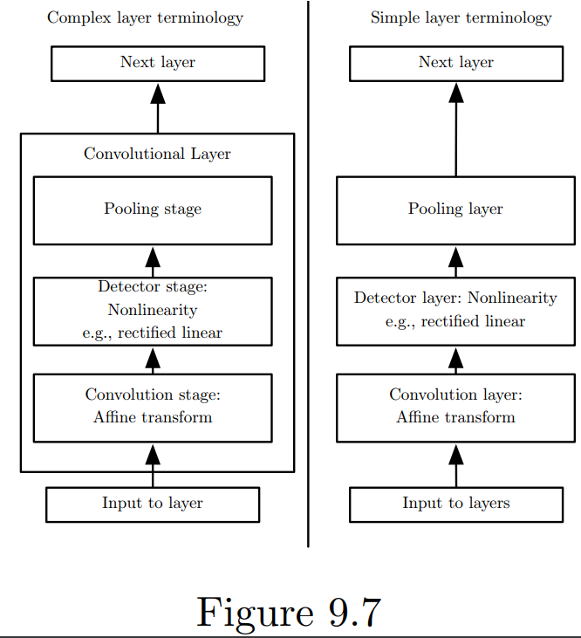
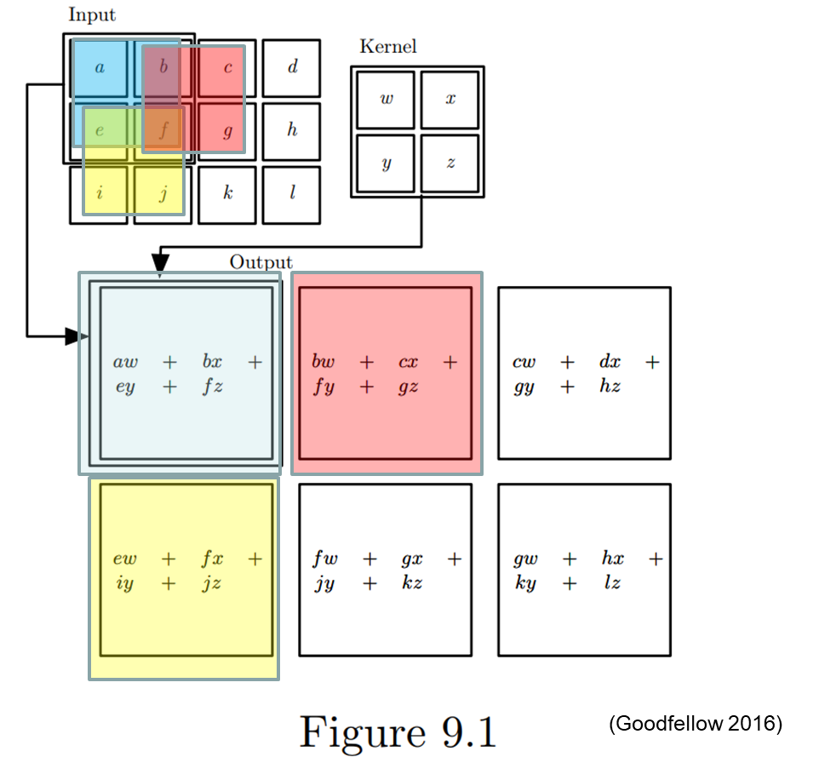
What’s in a CNN layer?
e.g. ReLU
(Goodfellow 2016)

Slide 26
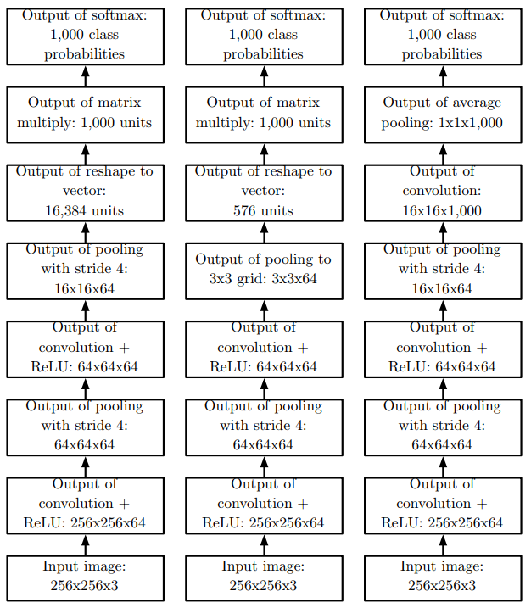
Same Task; Many Possible Architectures

Slide 27
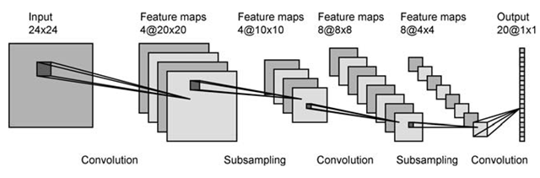
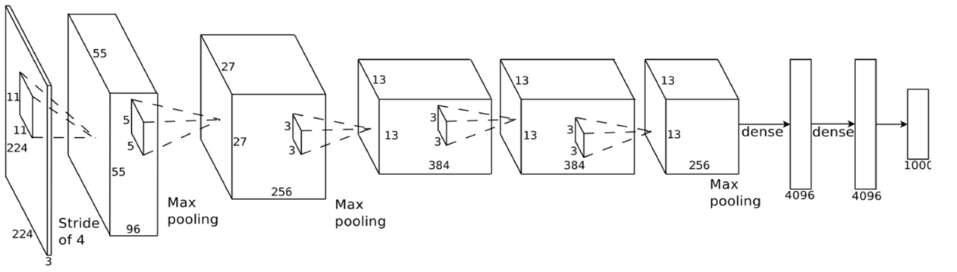
More network examples

Slide 28
CNN Backprop Intuition (1): Rethinking convolution
CNN with Kernel multiplication can be described as sliding dot-products
Each step
Is equivalent to converting input (h) and (padded, sparse) kernel (k) into 1d vector and performing dot(h.T,k)
Step generates a scalar
CNN step/stride generates 1 scalar per step; all steps together generate an output vector
Output of convolution is a vector that can be reshaped into a 2D matrix

Slide 29
CNN backprop intuition (2) Rethinking convolution
Convolution of an image with one kernel could be thought of as just flattening the input and doing matrix multiplication with a series of stacked sparse kernel vectors, then reshaping the output vector into a 2D array
Thus, convolution is really just matrix multiplication… and we already know how to do backprop on it

Slide 30
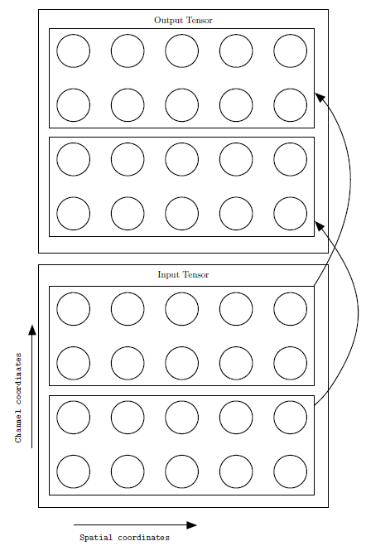
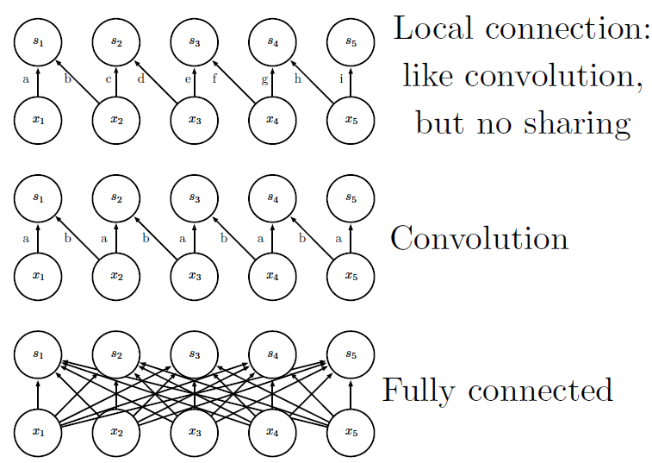
Connectivity
Connectivity within Channels

Slide 31
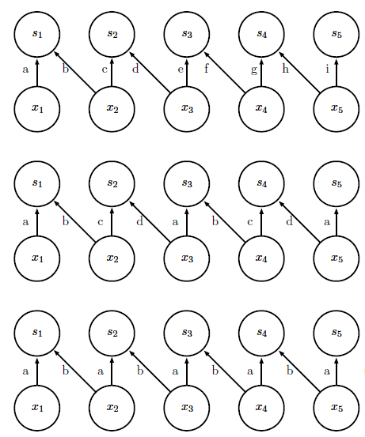
Tiled Convolution
Local Connection (no sharing)
Tiled Convolution (cycle between groups of shared parameters)
Convolution (one group shared everywhere)

Slide 32

Neuroscience Basis of CNN (1)
Primary Visual Cortex V1
Arranged in 2D spatial map
Simple cells ~ small local receptive field, simple linear function → Detector Units
Complex cells ~ detections invariant to small shifts in position of feature → Pooling, cross- channel pooling
Brain research using reverse correlation shows V1 cells have weights like Gabor functions

Slide 33
Neuroscience Basis of CNN (2)
Deeper brain structures designed to detect are invariant to transformations of input
Example: grandmother cell in the medial temporal lobe
Evidence of neurons can fire on individual concepts regardless of input type (audio, visual, text): evidence of the “Tom Hanks” neuron

Slide 34
Neuroscience-inspired active research for CNN (1)
Fovea only sees small (2 deg) patch of space; Saccades are ‘stitched’ in brain to give impression of full image
Other human senses integrated
Humans solve multiple tasks from same input (object & scene recognition, 3D localization…)
Brain heavily uses feedback from higher levels to lower levels
Brain (probably) uses different activation & pooling functions

Slide 35
Neuroscience-inspired active research for CNN (2)
Training the brain?
Backprop is probably not used in the brain – probably not biologically plausible; brain is always performing forward prop AND training simultaneously
Hebbian learning: “Neurons that fire together wire together”: similar timed & valued activations imply increased weights.

